Slide 1
Jee-Mentor-Website
Team Members: LCB2021042 - Vineet Kumar Verma
LCB2021021 - Amit Vikram Singh
LCB2021038 – Saka Rushendra Babu
LCB2021044 – Aryan Raj Singh
LCB2021034 – Govind Patidar
LCB2021033 – Vishal Kumar

Slide 2
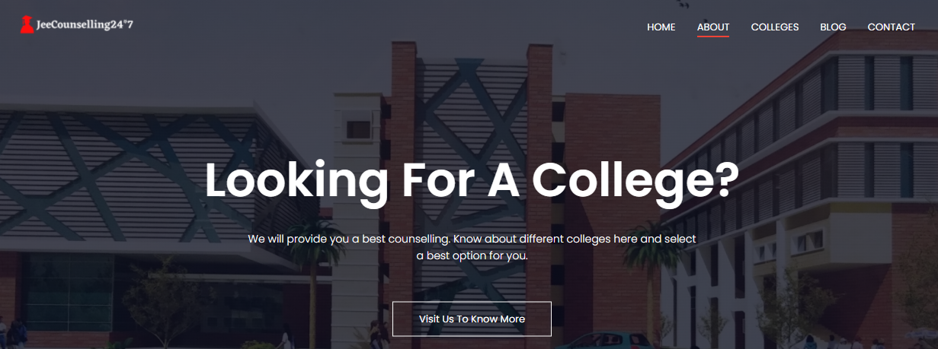
Header
Contains our own logo of website: JeeCounselling24*7
Contains 5 pages tags which is completely responsive
Visit Us To Know More => Responsive Button
Background Containing IIITL image
Compatible with small screen devices too.

Slide 3

Footer
About us with some sort description of our team
Contains Facebook, twitter, instagram & linkedin links : Completely responsive and openable
Contains message: Made with love by our webd team 11
Compatible with small screen devices too.

Slide 4

Home Page
Overall home page completely responsive
Have hovering properties
Compatible with small screen
Box shadow properties are there
Have reviews from user
Resposive buttons hyperlinked
Contains Facebook, twitter, instagram
& linkedin links : Completely responsive
and openable.

Slide 5
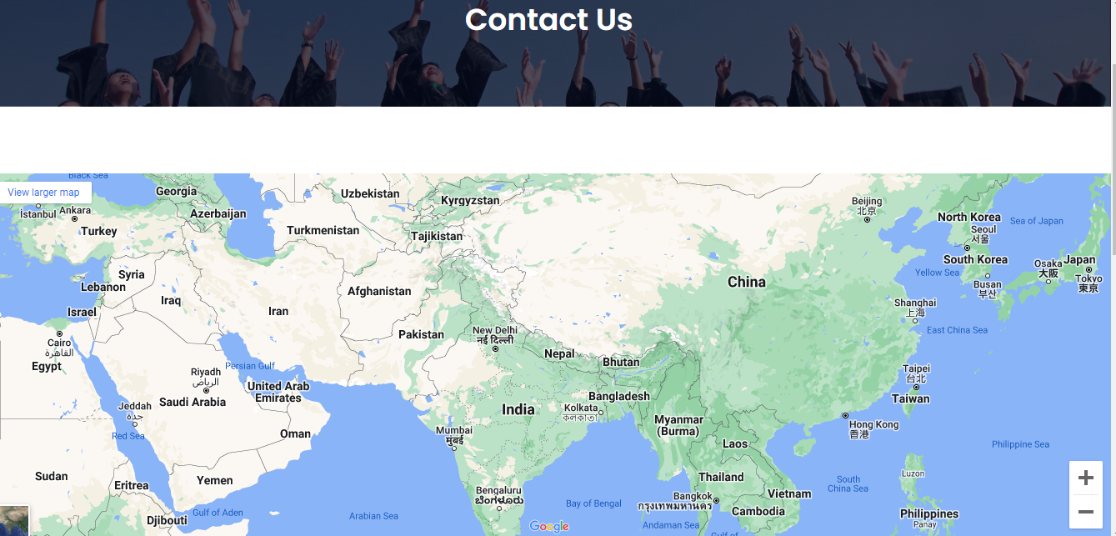
Contact Us Page
Contains a Google map

Slide 6
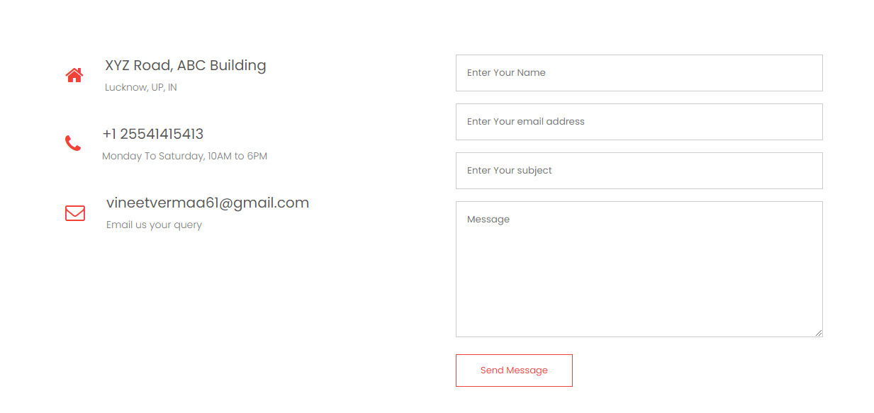
Contact Us Page
Contains some information about website owner
Contains completely responsive form which sends query message to website owner e-mail id.
Email should contain @ & all fields are compulsory.

Slide 7
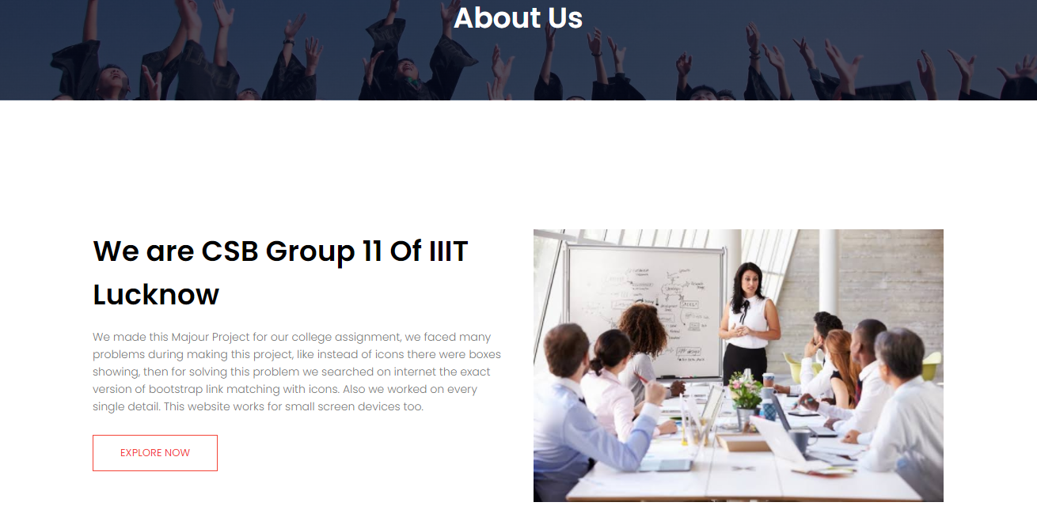
About Us Page
About us page contains some description of our website
A picture
And a responsive “Explore Now” button which redirects
to colleges page .

Slide 8
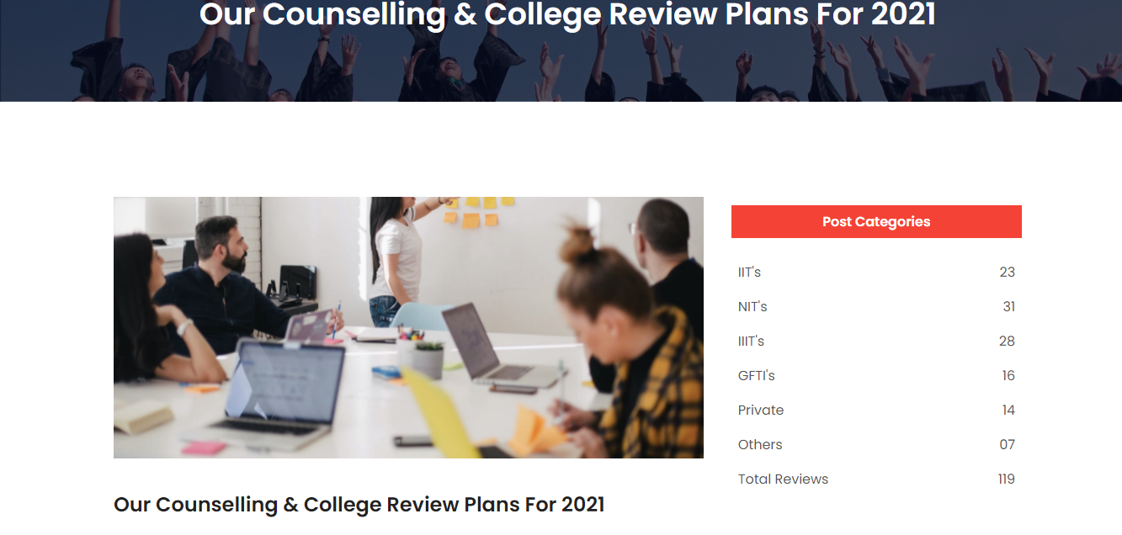
Blog Page
Contains an image & Displays some previous posts

Slide 9
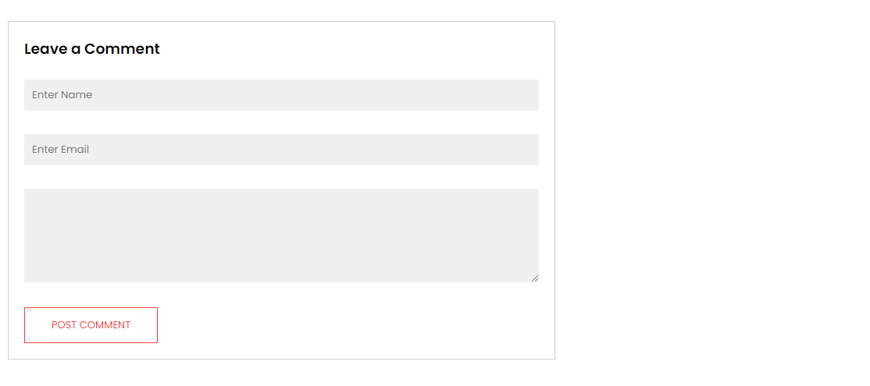
Blog Page
A completely responsive form is also available for posting comments.
Stretchable form.
Email should contain @ & all fields are compulsory.

Slide 10
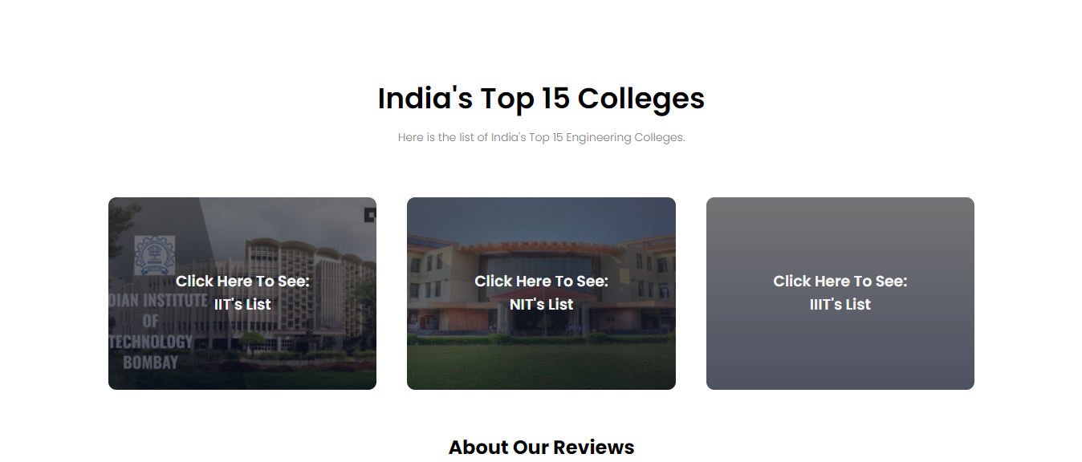
College Page
Major component of college page is it contains top IIT, NIT, IIIT colleges page links clicking on them you will go to that pages.

Slide 11
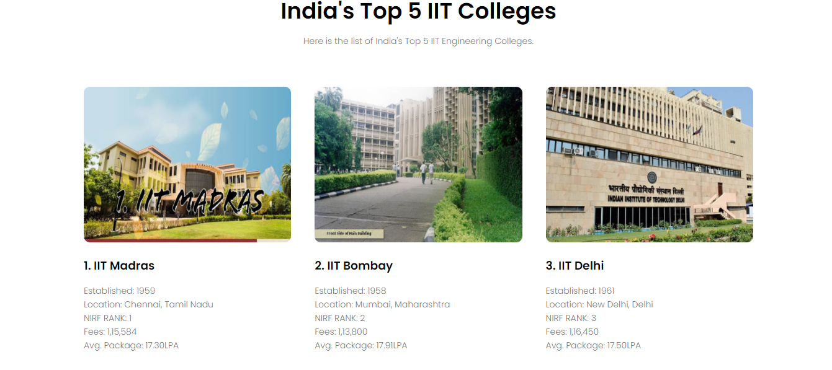
IIT Page
Contains useful counselling information about top IIIT’s.

Slide 12
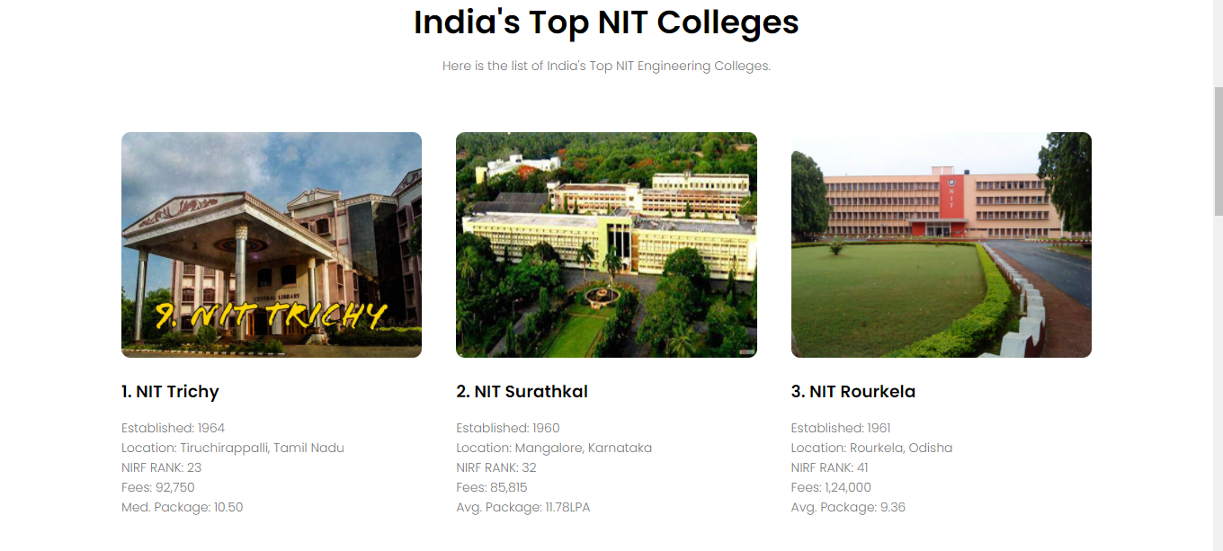
NIT Page
Contains useful counselling information about top NIIT’s.

Slide 13
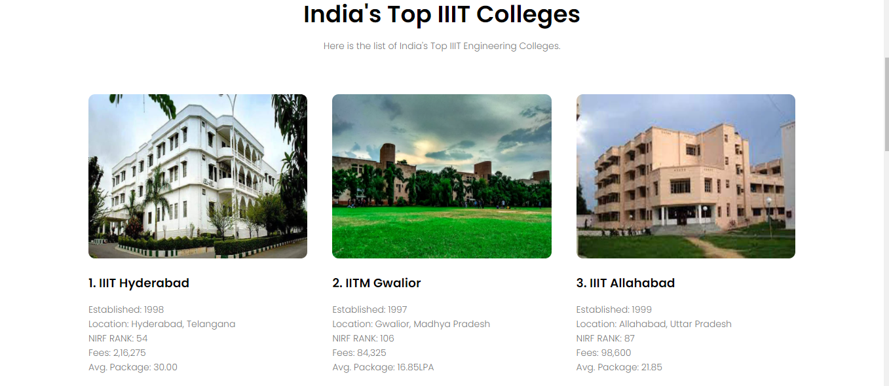
IIIT Page
Contains useful counselling information about top IIIT’s.

Slide 14
Thank You

